Slide 1
Inferencing
RI/L.7.1 - I can refer to the text to support my thoughts and draw inferences about a story/informational text; and analyze questions about a story/informational text to determine what specifically is being asked in order to provide appropriate evidence and explicitly explain how the answer is supported by the text.
RI/L.7.2 - I can analyze details from the text to determine the theme or message of a story or informational text.

Slide 2
Inferences - Drawing Conclusions
Making inferences sounds like a big scary task; but, remember, it is really just making an educated guess. You take what you know from your own life's experiences and pair it with what observe or read, and you come to a conclusion.
Vocab Review
Inference: A logical conclusion made from evidence and reasoning.
Fallacy: An incorrect conclusion, especially one based on unsound reasoning.

Slide 3


Slide 4

Yellowbook commercial

Slide 5
Yellowbook inferencing
What just happened?
How do you know?

Slide 6
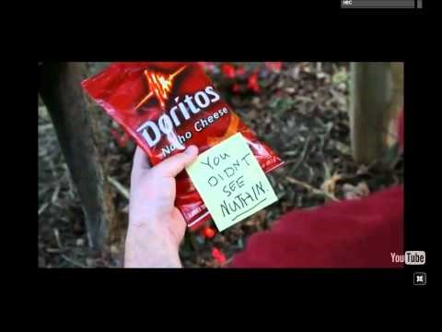
Doritos super bowl commercial

Slide 7
Doritos super bowl inferencing
What did the dog do?
How do you know?
Why did the dog give the man a bag of chips?

Slide 8

Chevy Happy Grad commercial

Slide 9
Chevy Happy Grad inferencing
What does the graduate think his gift is?
What was actually his gift?

Slide 10
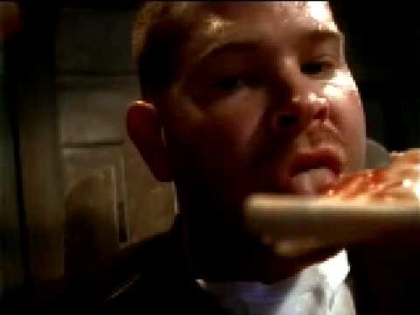
Tabasco “mosquito” commercial

Slide 11
Tabasco “mosquito” inferencing
What happened to the mosquito?
What caused the explosion?

Slide 12
Inferencing Activity roles:
Working With Shoulder Partners:
1&3’s – Examine the text to infer the answers to odd #’d questions and explain to your shoulder partner why you made that inference.
2&4’s – Locate at least one detail in the text that supports your shoulder partner’s inference.
Use a blank piece of notebook paper to brainstorm and take notes during this phase of the activity. Do not record answers on activity sheet.

Slide 13
Inferencing Activity roles:
Working With Whole Pod: Discuss responses to all questions using the assigned roles. Determine and record your pod’s answer.
1 – Interrogator – Have the other shoulder partner pair give their answer to each set of questions and lead a discussion comparing your responses to theirs.
2 – Investigator – Examine the passage to determine which response was most correct.
3 – Informer – Use the information gathered by the interrogator and investigator to compose responses to each set of questions for your pod.
4 – Recorder – Work with the informer and record the pod’s answers. Utilize feedback from all pod members to construct the final response.
Switch roles after each set of questions (1&2, 3&4 … so on).

